Slide 1

Sales Classification and Prediction
DATA 606 – Capstone Project in Data Science Under the guidance of Professor Dr. Chaojie Wang
By
Sai Gangadhar Veeramreddy
CS68859

Slide 2
Introduction
The goal of the analysis is to get insights, patterns, and trends to inform decision-making and advance sales strategies.
Retail sales data analysis is vital for several reasons:
Business Optimization: It helps retailers enhance inventory management, pricing, and marketing strategies to make the most of profits.
Customer Insights: It offers insights into customer preferences and behaviors, permitting personalized marketing and product recommendations.
Seasonal Planning: Retailers can make plans for seasonal trends and holiday sales, guaranteeing they meet customer demand.

Slide 3
Background
This project is all about using data to help retail businesses make better decisions. The primary objective of this project is to offer a comprehensive understanding of the retail landscape, enabling businesses to make data-driven decisions that enhance their operations, boost profitability, and ultimately enrich the customer experience. By doing this, we can discover important trends and patterns that can help stores improve their operations, make more money, and give customers a better shopping experience. In the end, the goal is to give retailers the tools they need to succeed in a competitive market by using data in smart ways.

Slide 4
About Data and Dataset
Historical sales data for 45 stores located in different regions - each store contains many departments. The company also runs several promotional markdown events throughout the year. These markdowns precede prominent holidays, the four largest of which are the Super Bowl, Labor Day, Thanksgiving, and Christmas. The weeks including these holidays are weighted five times higher in the evaluation than non-holiday weeks.
Stores
Anonymized information about the 45 stores, indicating the type and size of the store.

Slide 5
About Dataset (continuation…)
Features
Contains additional data related to the store, department, and regional activity for the given dates.
Store - the store number
Date - the week
Temperature - average temperature in the region
Fuel_Price - cost of fuel in the region
MarkDown1-5 - anonymized data related to promotional markdowns. MarkDown data is only available after Nov 2011 and is not available for all stores all the time. Any missing value is marked with an NA
CPI - the consumer price index
Unemployment - the unemployment rate
IsHoliday - whether the week is a special holiday week

Slide 6
About Dataset (continuation…)
Sales
Historical sales data, which covers 2010-02-05 to 2012-11-01. Within this tab you will find the following fields:
Store - the store number
Dept - the department number
Date - the week
Weekly_Sales - sales for the given department in the given store
IsHoliday - whether the week is a special holiday week

Slide 7
Research Questions
Sales Prediction
Markdown Impact Analysis
Store Clustering
Holiday Sales Assessment

Slide 8
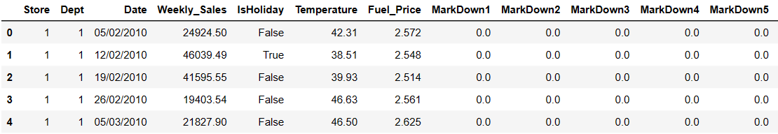
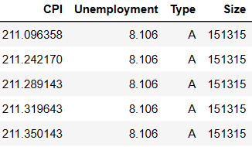
Exploratory Data Analysis (EDA)
Final Data Set

Slide 9
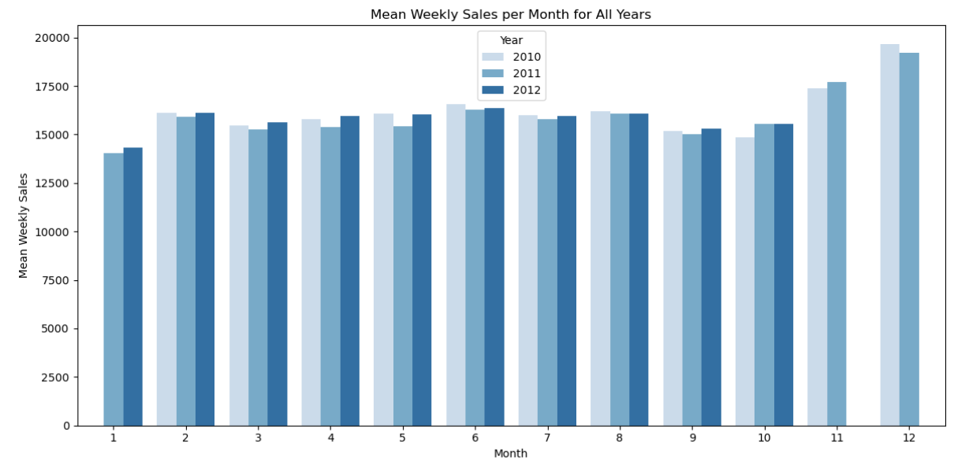
Mean Weekly Sales Per Month for 2010, 2011, and 2012

Slide 10
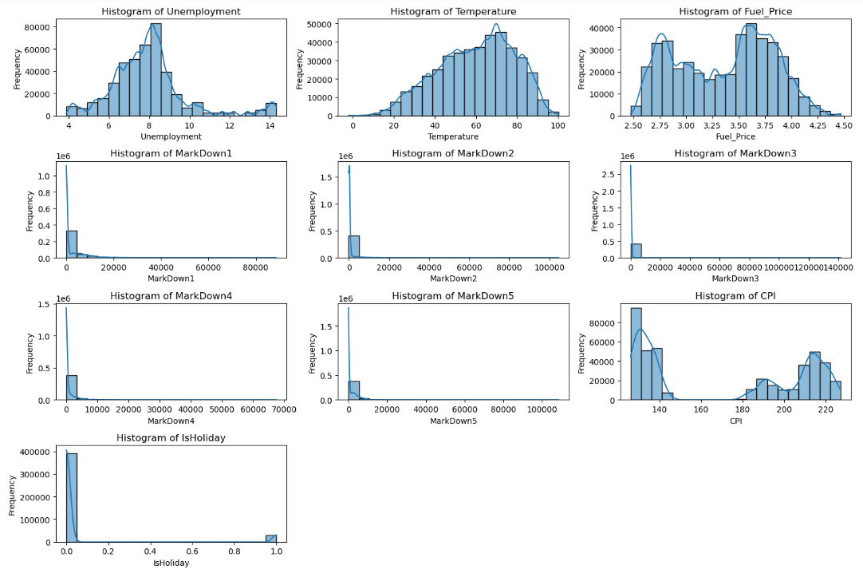
Markdown Impact on Sales

Slide 11
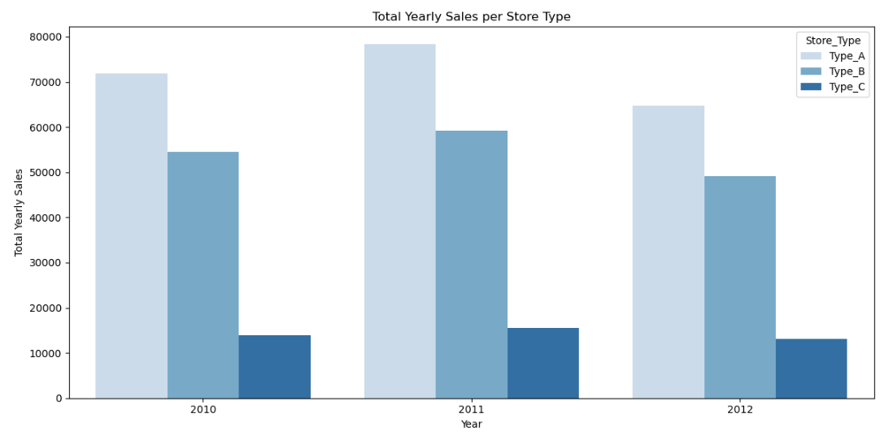
Store Clustering on type of the store

Slide 12
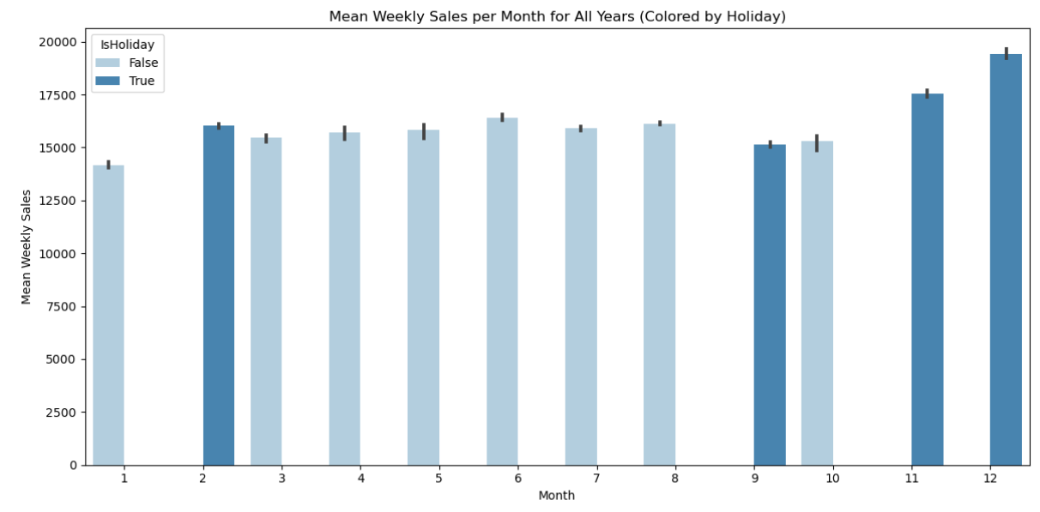
Holidays Affect on Sales

Slide 13
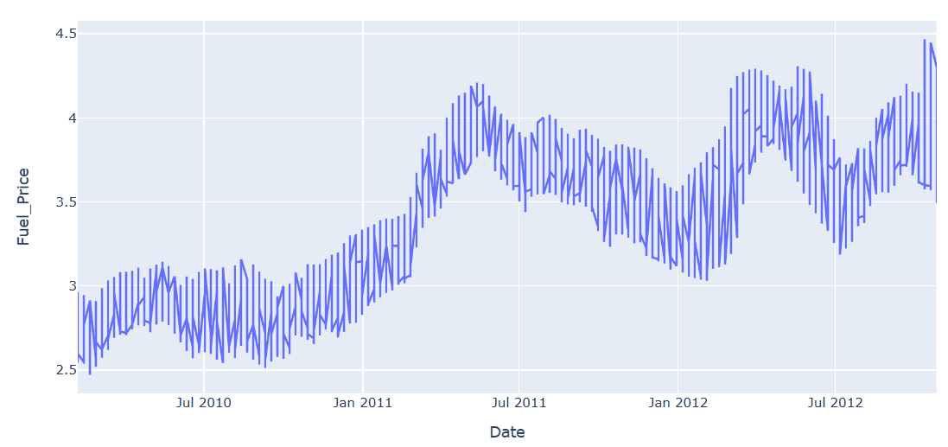
Long-Term Tilt Data for Fuel Price Changes

Slide 14
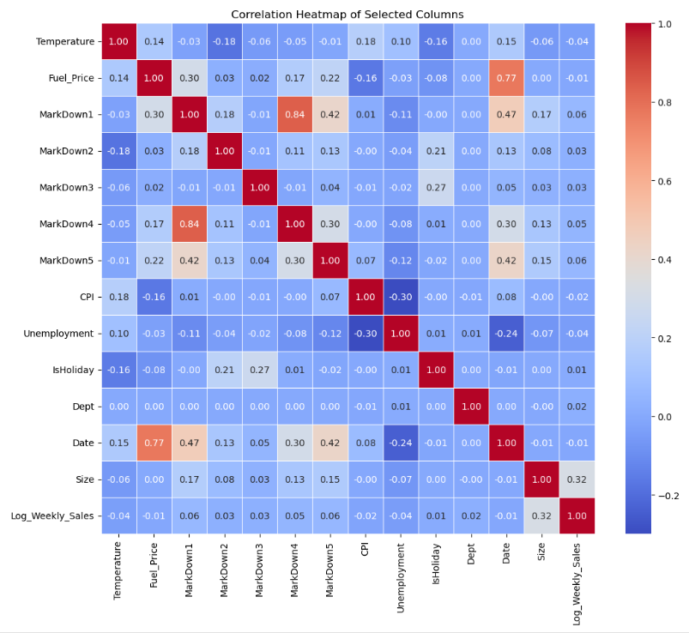
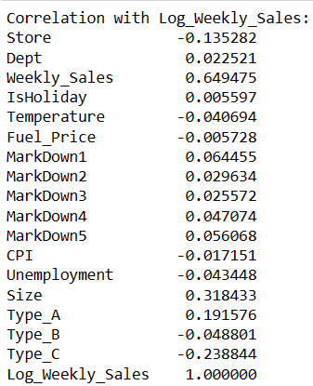
Correlation Matrix

Slide 15
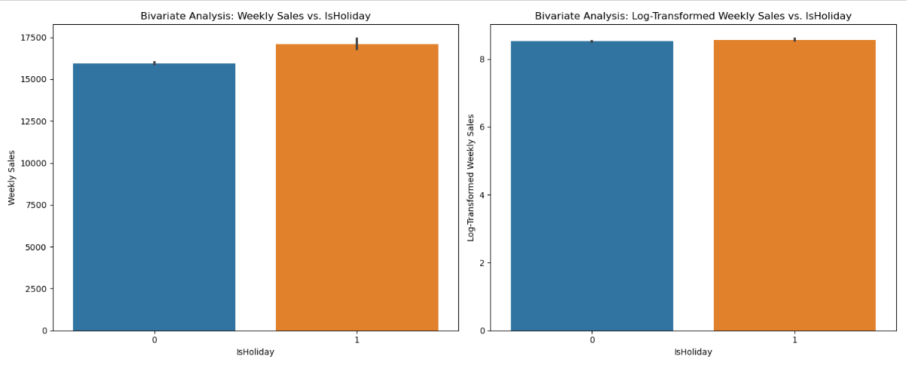
Applying log transformation

Slide 16
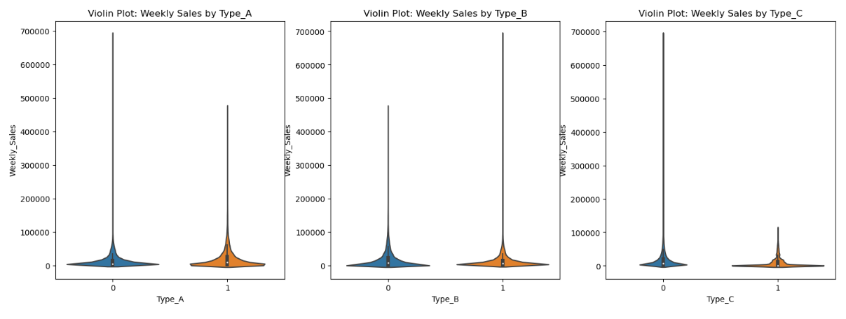
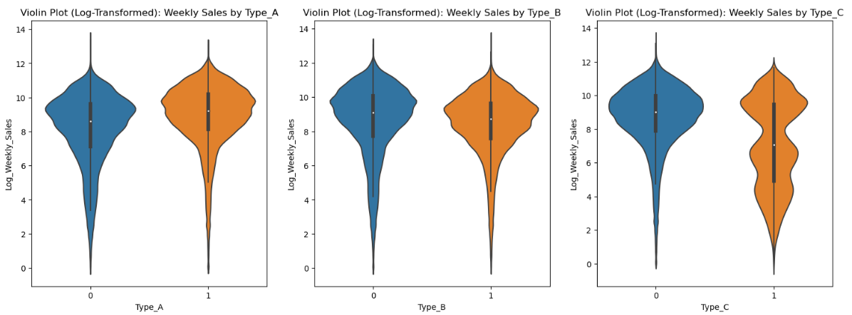

Slide 17
Variables Selection for Models
Target Variable
Feature Variables
Log_Weekly_Sales
Store Number
Isholiday
Temperature
Fuel_Price
CPI
Unemployment rate
type of store
size of store

Slide 18
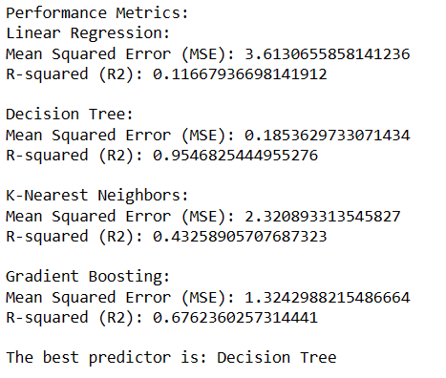
Model Comparison
The dataset was originally split into training and testing sets, using an 80/20 ratio. This split was selected to maintain a balance between a satisfactorily large training dataset for vigorous model development and a reserved portion for model evaluation.
The models used are Linear Regression, Decision Tree, K-Nearest, and Gradient Boosting.

Slide 19
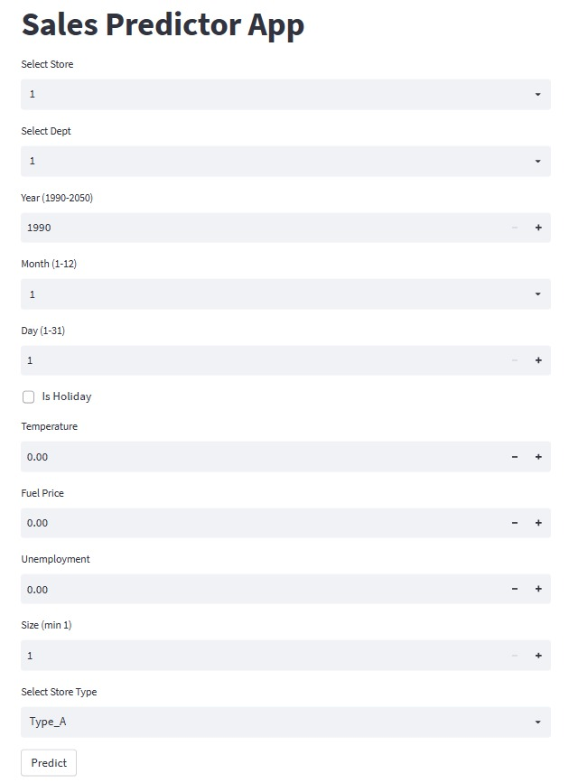
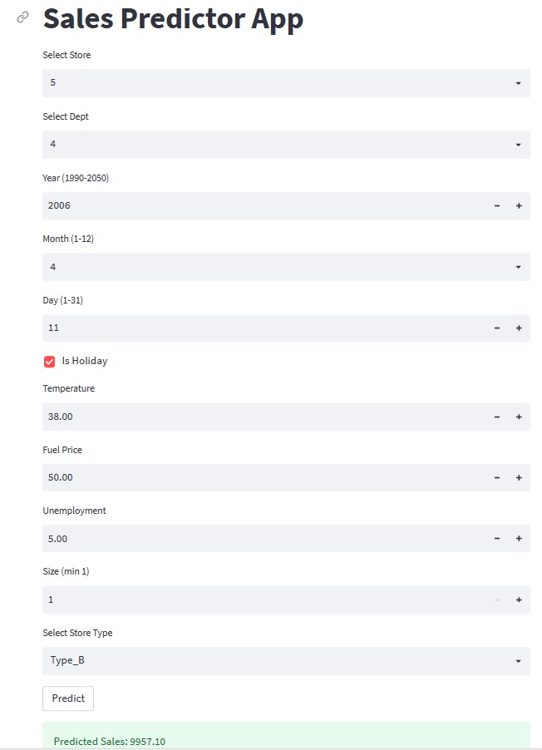
Model Deployment

Slide 20
Conclusion
The potential applications of this work are significant:
Business Optimization: Retailers can use the understanding gained from the analysis to improve inventory management, pricing strategies, and marketing campaigns. Understanding store types and factors influencing sales can lead to more operative decision-making.
Customer Personalization: By recognizing store types and their characteristics, retailers can modify their offerings and marketing efforts to specific customer segments. This can improve customer experiences and loyalty.
Seasonal Planning: The analysis can help retailers get ready for seasonal trends and holiday sales, ensuring satisfactory stock and promotional strategies.

Slide 21
Future Work
Franchise Owners
Store Owners
Dealers
Customers

Slide 22


